Slide 1

8th Grade Math: Pre-Algebra
Unit 4, Lesson 3 Applying Exponent Laws Volume 1, pg. 134

Slide 2


Benchmark
MA.8.NSO.1.3
Extend previous understanding of the Laws of Exponents to include integer exponents. Apply the Laws of Exponents to evaluate numerical expressions and generate equivalent numerical expressions, limited to integer exponents and rational number bases, with procedural fluency.
volume 1, pg. 134

Slide 3
Integrated Mathematical Thinking and Reasoning Standards
MA.K12.MTR.3.1 Complete tasks with mathematical fluency.
MA.K12.MTR.4.1 Engage in discussions that reflect on the mathematical thinking of self and others.
volume 1, pg. 134

Slide 4

Learning Target
I can apply the laws of exponents to generate equivalent numerical expressions.
volume 1, pg. 134

Slide 5

Warm-Up
volume 1, pg. 135

Slide 6
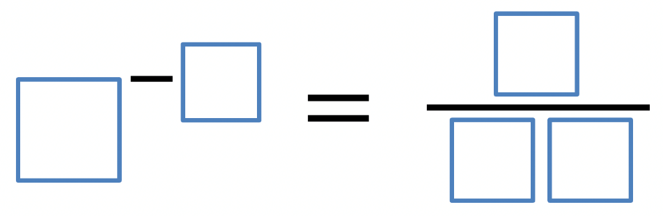
4.3.1 Warm-Up: Negative Exponents
Place a digit in each blue box to make the statement true. Use only digits 0 to 9, at most one time each.
volume 1, pg. 135
Notes:
Video Link: https://algebranation.wistia.com/medias/fi4fidi5y8

Slide 7

Collaboration
volume 1, pg. 135

Slide 8

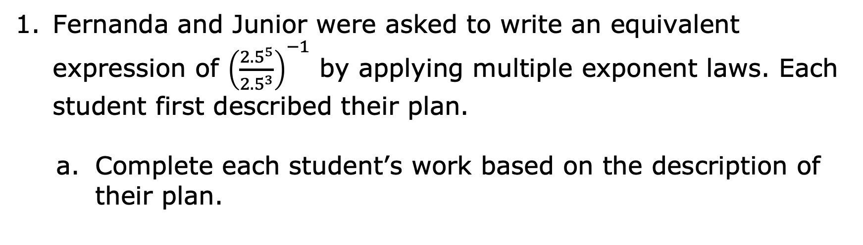
4.3.2 Collaboration: Applying More Than One Exponent Law
Fernanda and Junior were asked to write an equivalent expression of ${\left(\frac{{2.5}^{5}}{{2.5}^{3}}\right)}^{−1}$ by applying multiple exponent laws. Each student first described their plan.
Complete each student’s work based on the description of their plan.
volume 1, pg. 135

Slide 9
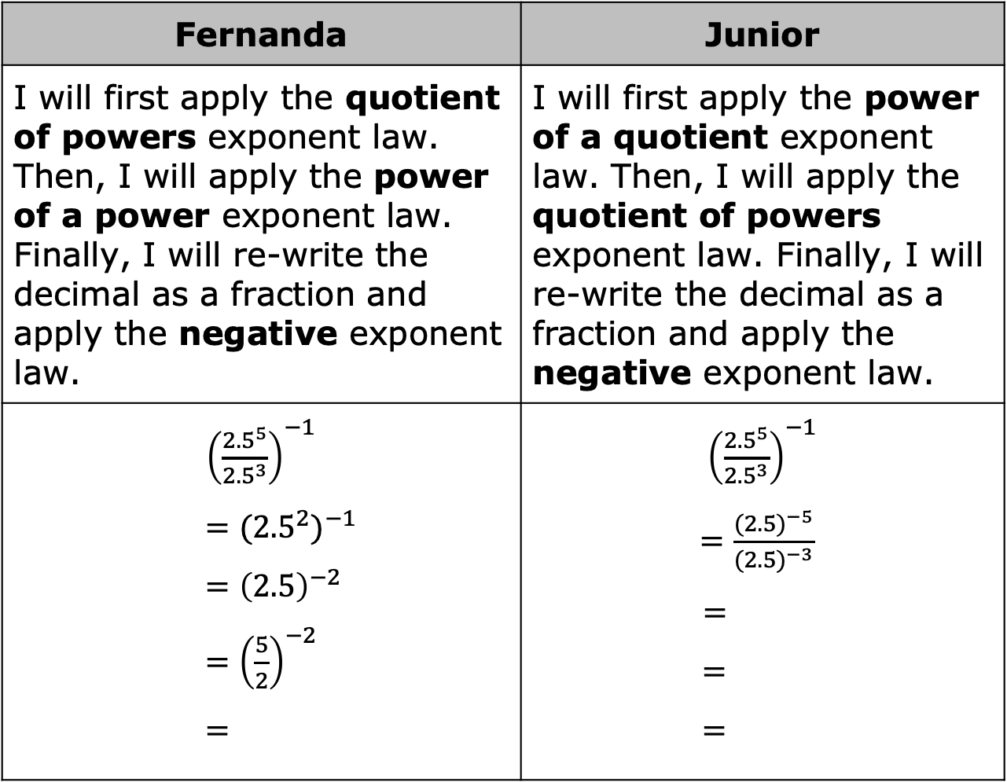
Fernanda | Junior
I will first apply the quotient of powers exponent law. Then, I will apply the power of a power exponent law. Finally, I will re-write the decimal as a fraction and apply the negative exponent law. | I will first apply the power of a quotient exponent law. Then, I will apply the quotient of powers exponent law. Finally, I will re-write the decimal as a fraction and apply the negative exponent law.
${\left(\frac{{2.5}^{5}}{{2.5}^{3}}\right)}^{−1}$ $$={{(2.5}^{2})}^{−1 }$$ $$={\left(2.5\right)}^{−2}$$ $={\left(\frac{5}{2}\right)}^{−2}$ $$=$$ | ${\left(\frac{{2.5}^{5}}{{2.5}^{3}}\right)}^{−1}$ $=\frac{{(2.5)}^{−5}}{{(2.5)}^{−3}}$ $$=$$ $$=$$ $$=$$
volume 1, pg. 135

Slide 10
Explain which method you prefer.
Ask your partner which method they prefer. Summarize your partner’s explanation.
volume 1, pg. 136

Slide 11

Activity
volume 1, pg. 136

Slide 12

4.3.3 Activity: Roundtable
In teams of three, assign a number (1–3) to each team member. Each student will complete the first step of their assigned problem and identify the exponent law used.
Then, pass the problem to the student on your right to check the work and complete the next step in the problem.
For each new step, continue passing the problems to the student on your right until the problems have one base and one exponent.
volume 1, pg. 136

Slide 13
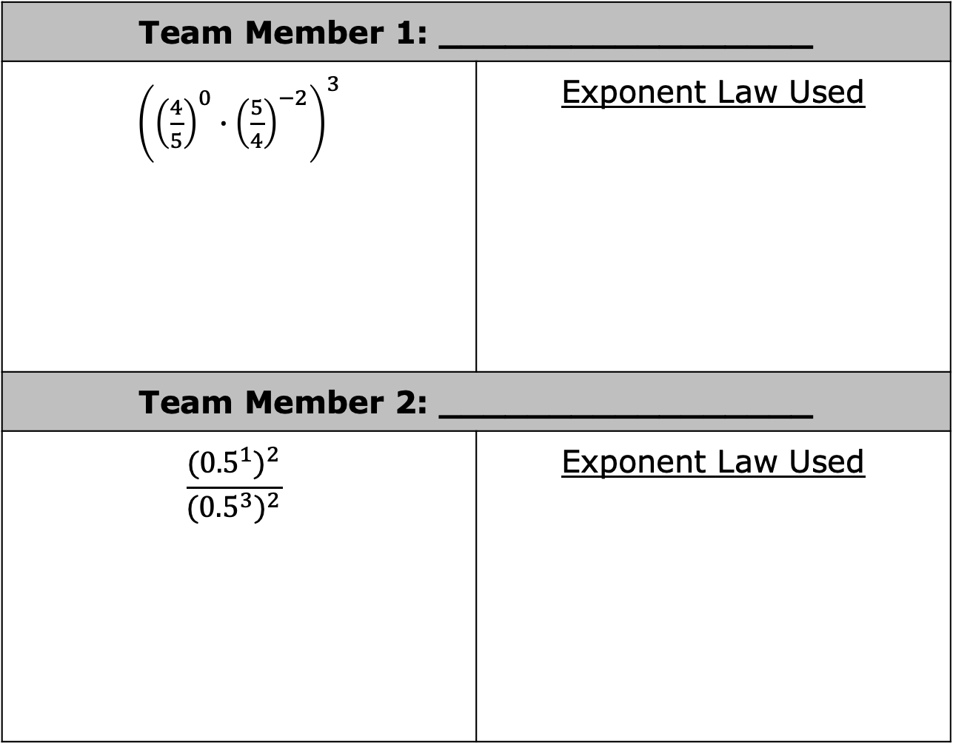
Team Member 1: _________________
${\left({\left(\frac{4}{5}\right)}^{0}∙{\left(\frac{5}{4}\right)}^{−2}\right)}^{3}$ | Exponent Law Used
Team Member 2: _________________
$$\frac{{({0.5}^{1})}^{2}}{{({0.5}^{3})}^{2}}$$ | Exponent Law Used
volume 1, pg. 136

Slide 14
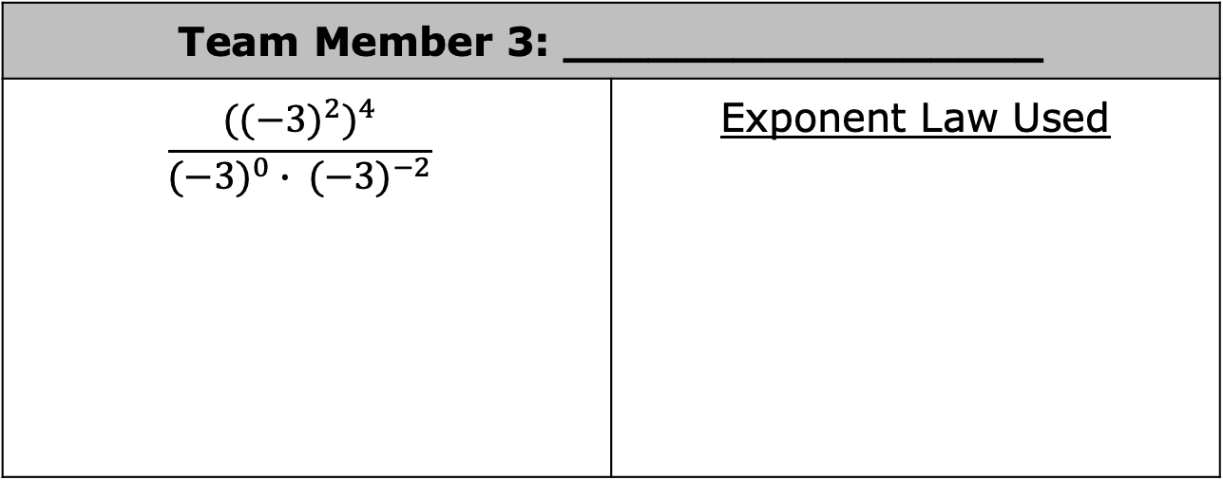
Team Member 3: _________________
$$\frac{{{((−3)}^{2})}^{4}}{{(−3)}^{0} ∙ {(−3)}^{−2}}$$ | Exponent Law Used
volume 1, pg. 136

Slide 15
Collaboration
volume 1, pg. 137

Slide 16
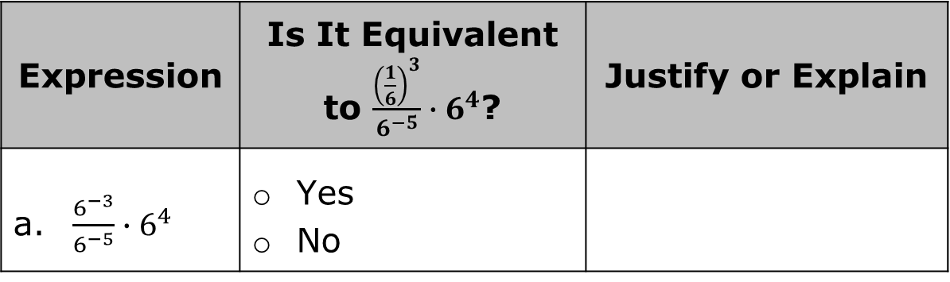
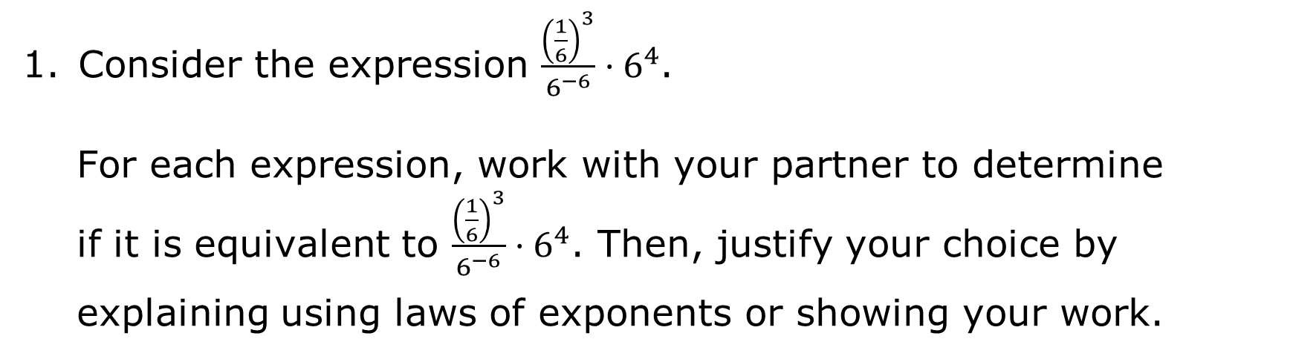
4.3.4 Collaboration: Equivalent Expressions
Consider the expression $\frac{{\left(\frac{1}{6}\right)}^{3}}{6^{−6}}·6^{4}$.
For each expression, work with your partner to determine if it is equivalent to $\frac{{\left(\frac{1}{6}\right)}^{3}}{6^{−6}}·6^{4}$. Then, justify your choice by
explaining using laws of exponents or showing your work.
Expression | Is It Equivalent to $\frac{{\left(\frac{1}{6}\right)}^{3}}{6^{−5}}∙6^{4}$? | Justify or Explain
a. $\frac{6^{−3}}{6^{−5}}{∙6}^{4}$ | Yes No
volume 1, pg. 137

Slide 17
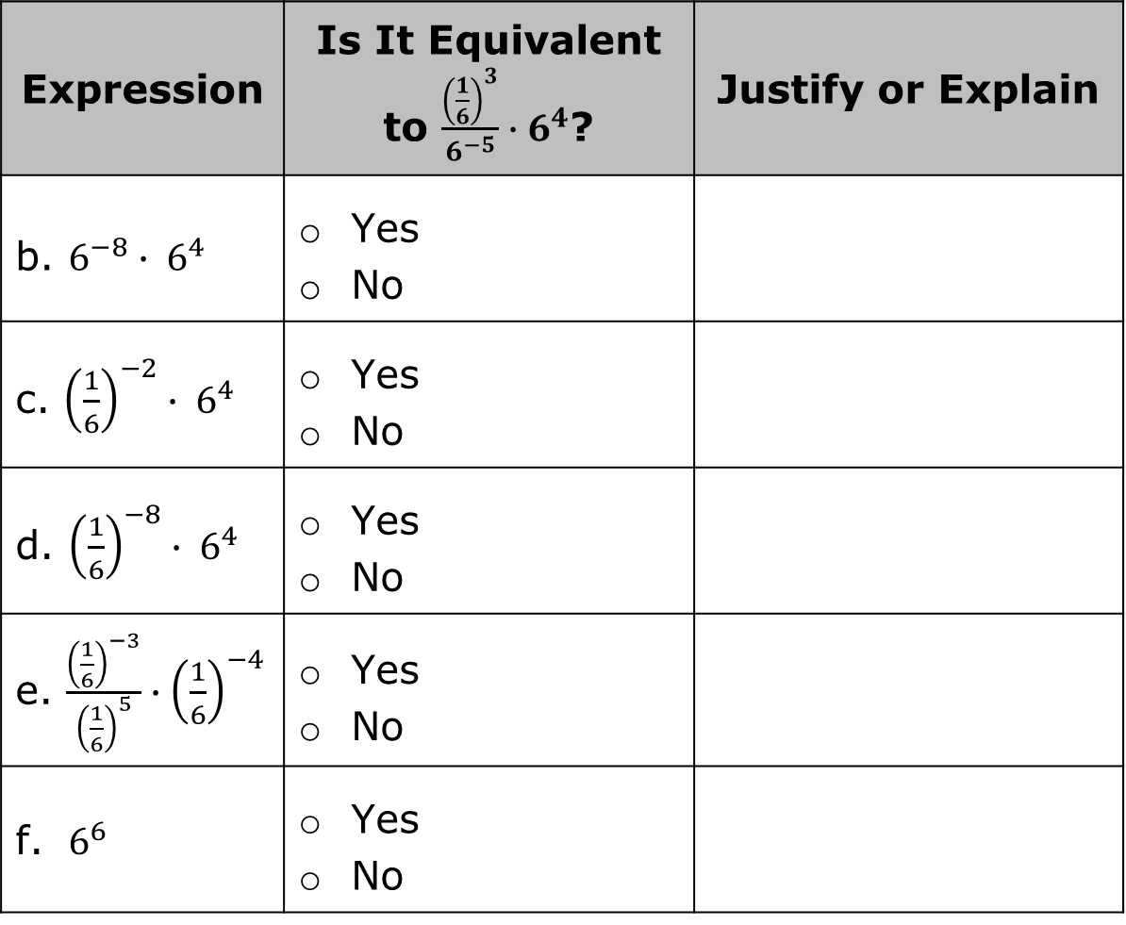
Expression | Is It Equivalent to $\frac{{\left(\frac{1}{6}\right)}^{3}}{6^{−5}}∙6^{4}$? | Justify or Explain
b. $6^{−8}∙ 6^{4}$ | Yes No
c. ${\left(\frac{1}{6}\right)}^{−2}∙ 6^{4}$ | Yes No
d. ${\left(\frac{1}{6}\right)}^{−8}∙ 6^{4}$ | Yes No
e. $\frac{{\left(\frac{1}{6}\right)}^{−3}}{{\left(\frac{1}{6}\right)}^{5}}∙{\left(\frac{1}{6}\right)}^{−4}$ | Yes No
f. $6^{6}$ | Yes No
volume 1, pg. 137

Slide 18

Your Turn
volume 1, pg. 138

Slide 19
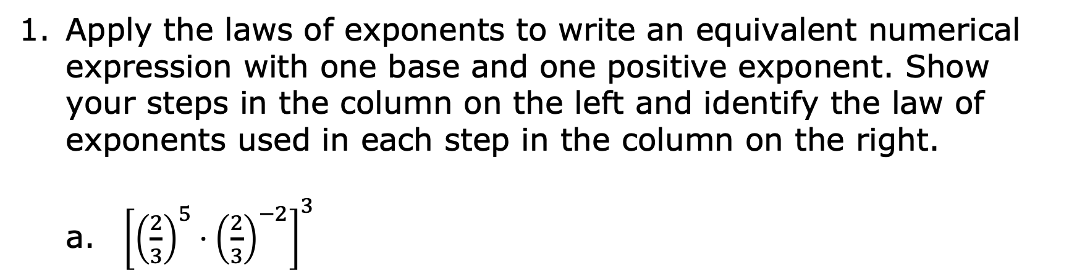
4.3.5 Your Turn!
Apply the laws of exponents to write an equivalent numerical expression with one base and one positive exponent. Show your steps in the column on the left and identify the law of exponents used in each step in the column on the right.
${\left[{\left(\frac{2}{3}\right)}^{5}·{\left(\frac{2}{3}\right)}^{−2}\right]}^{3}$
Steps | Laws of Exponents
volume 1, pg. 138

Slide 20
$\frac{5^{4}·5^{4}}{5^{3}}$
Steps | Laws of Exponents
volume 1, pg. 138

Slide 21

Wrap-Up
volume 1, pg. 138

Slide 22
4.3.6 Wrap-Up: Reflection
Color in the arrow up to the statement that best describes your current understanding of today’s learning target.
I can apply the Laws of Exponents to generate equivalent numerical expressions.
 | I’m so confident, I could explain this to someone else!
 | I can get to the right answer, but I don’t understand well enough to explain it yet.
 | I understand some of this, but I don’t understand all of it yet.
 | I tried hard and I listened, but I am finding this challenging. I will make sure that I get help with this next lesson.
 | I do not understand any of this yet. There are things I could do to be a better learner next lesson.
volume 1, pg. 138

